Slide 1
Compiler Optimizations for Machine Learning Workloads
Bojian Zheng
CSCD70 Compiler Optimization
2023/3/20

Slide 2

Announcements
The lecture & tutorial next week (i.e., 2023/03/27) will be cancelled.
Assignment 3 will be released this Friday (i.e., 2023/03/24).
2 weeks will be given.
Covers loop invariant code motion and register allocation.

Slide 3
Agenda
0. Background: Deep Neural Networks
1. Machine Learning Systems
2. Memory Optimizations

Slide 4

When in doubt, ASK

Slide 5


Hypes in Machine Learning
Image Synthesis
Chat Bot
https://stablediffusionweb.com/
https://openai.com/blog/chatgpt

Slide 6
Deep Neural Networks
An important class of machine learning algorithms, usually interpreted as graphs.
Graph visualization of ResNet-50, an image classification model

Slide 7
Deep Neural Networks
An important class of machine learning algorithms, usually interpreted as graphs.
Graph visualization of ResNet-50, an image classification model
Graph = Nodes (i.e., Operators) + Edges (i.e., Tensors) Tensor = NDArray = Multi-dimensional array

Slide 8


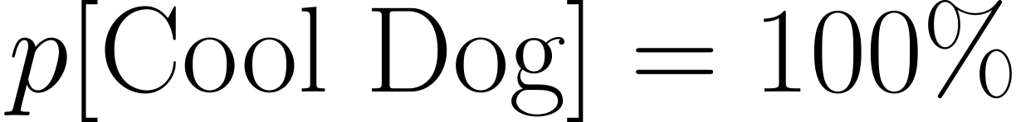
Deep Neural Networks
3 phases:
❶ Forward Pass
Deep Neural Network
Model parameters W

Slide 9
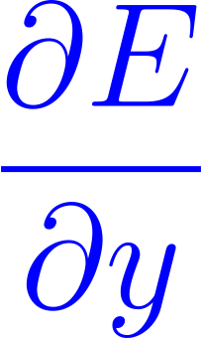

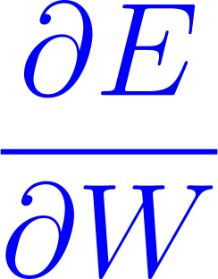
Deep Neural Networks
3 phases:
❶ Forward Pass, ❷ Backward Pass
Deep Neural Network
Training loss
Model parameters W

Slide 10
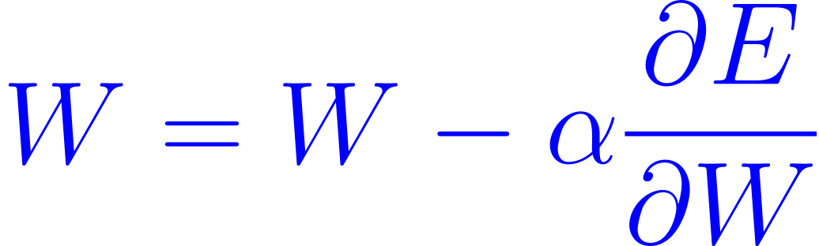
Deep Neural Networks
3 phases:
❶ Forward Pass, ❷ Backward Pass, and ❸ Weight Update
Deep Neural Network
Model parameters W
Learning rate

Slide 11
Deep Neural Networks
3 phases:
❶ Forward Pass, ❷ Backward Pass, and ❸ Weight Update
Training: Learn the model parameters.
Deep Neural Network
Model parameters W

Slide 12
Deep Neural Networks
3 phases:
❶ Forward Pass, ❷ Backward Pass, and ❸ Weight Update
Inference: Forward only to obtain the output labels.
Deep Neural Network
Model parameters W

Slide 13
Section Summary
Deep neural networks: graphs of operators and tensors.
3 phases & 2 modes of operation:
Training: Forward, Backward, and Weight Update
Inference: Forward only
These special properties call for domain-specific system design.

Slide 14
Machine Learning Systems
Machine Learning Systems Overview
TensorFlow & PyTorch: Declarative vs. Imperative
Evolution of PyTorch Compiler Design

Slide 15
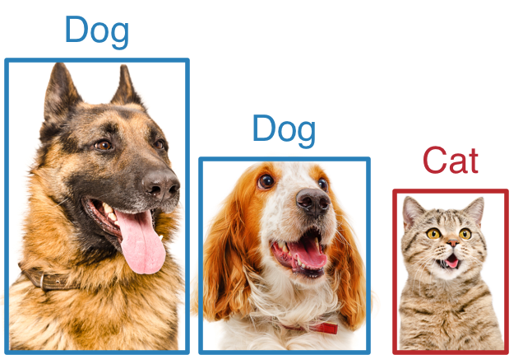



Machine Learning Systems Overview
Application
Image Classification
Machine Translation
Speech Recognition

Slide 16
Machine Learning Systems Overview
Application
Image Classification

Slide 17
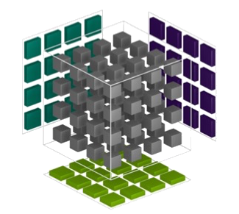
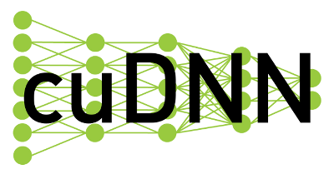
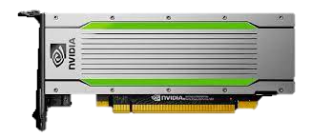
Machine Learning Systems Overview
Vendor Libraries
Invoke
Operator (e.g., Convolution)
cuBLAS
Hardware
NVIDIA GPU

Slide 18



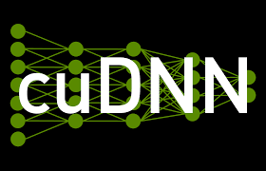

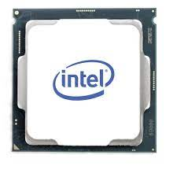

Machine Learning Systems Overview
Python Programming Front-end
Apply generically to many state-of-the-art systems.
C++ Framework Core
Vendor APIs & Libraries
Hardware Accelerators
NVIDIA GPUs
Intel CPUs
AMD GPUs

Slide 19

Machine Learning Systems Overview
Sounds like LLVM?
Python Programming Front-end
Apply generically to many state-of-the-art systems.
Bridge the gap between frontends and backends
C++ Framework Core
Vendor APIs & Libraries
Hardware Accelerators
NVIDIA GPUs
Intel CPUs
AMD GPUs

Slide 20

TensorFlow (V1)
One of the first mature machine learning frameworks that support GPUs.
Declarative programming paradigm:
import tensorflow as tf
a = tf.placeholder()
b = tf.placeholder()
c = a + b
with tf.Session() as sess:
sess.run(
c, feed_dict={a: 10, b: 32}
)

Slide 21
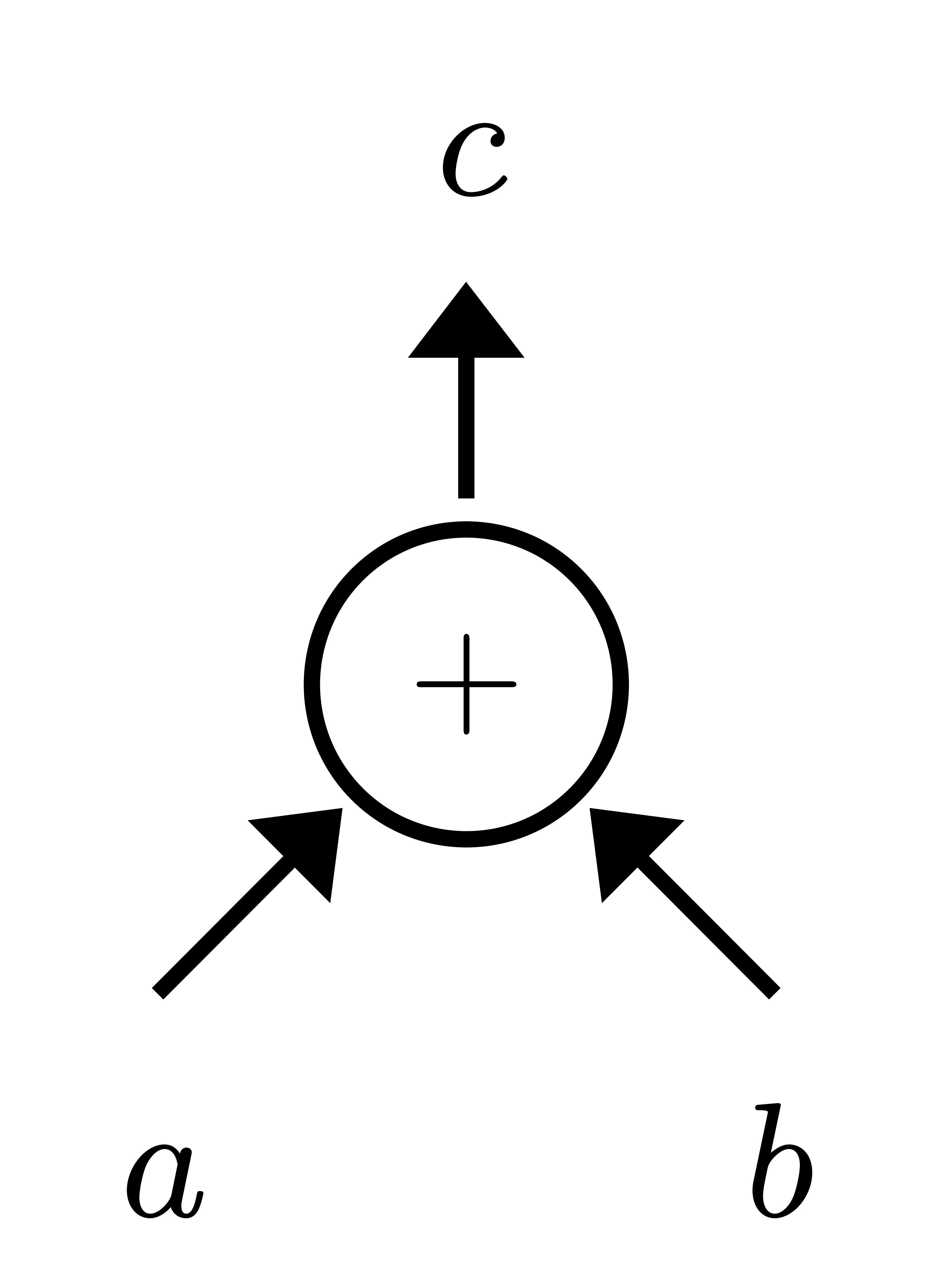
TensorFlow (V1)
One of the first mature machine learning frameworks that support GPUs.
Declarative programming paradigm:
import tensorflow as tf
a = tf.placeholder()
b = tf.placeholder()
c = a + b
with tf.Session() as sess:
sess.run(
c, feed_dict={a: 10, b: 32}
)

Slide 22
TensorFlow (V1)
One of the first mature machine learning frameworks that support GPUs.
Declarative programming paradigm:
import tensorflow as tf
a = tf.placeholder()
b = tf.placeholder()
c = a + b
with tf.Session() as sess:
sess.run(
c, feed_dict={a: 10, b: 32}
)

Slide 23
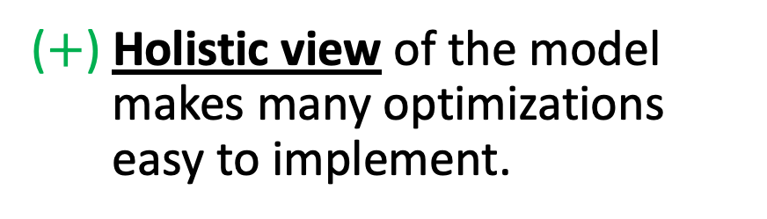
TensorFlow (V1)
One of the first mature machine learning frameworks that support GPUs.
Declarative programming paradigm
Key Idea: Create a compilable graph object in Python, an interpreter environment.
($+$) Holistic view of the model makes many optimizations easy to implement.
TensorFlow Grappler Optimizer, responsible for
Arithmetic optimizations, e.g., constant folding, common subexpression elimination, dead node elimination, …
Memory allocations
…

Slide 24
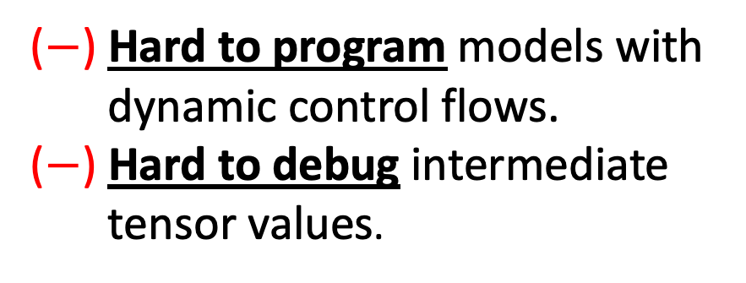
TensorFlow (V1)
One of the first mature machine learning frameworks that support GPUs.
Declarative programming paradigm
Key Idea: Create a compilable graph object in Python, an interpreter environment.
($+$) Holistic view of the model makes many optimizations easy to implement.
($−$) Hard to program models with dynamic control flows.
($−$) Hard to debug intermediate tensor values.

Slide 25

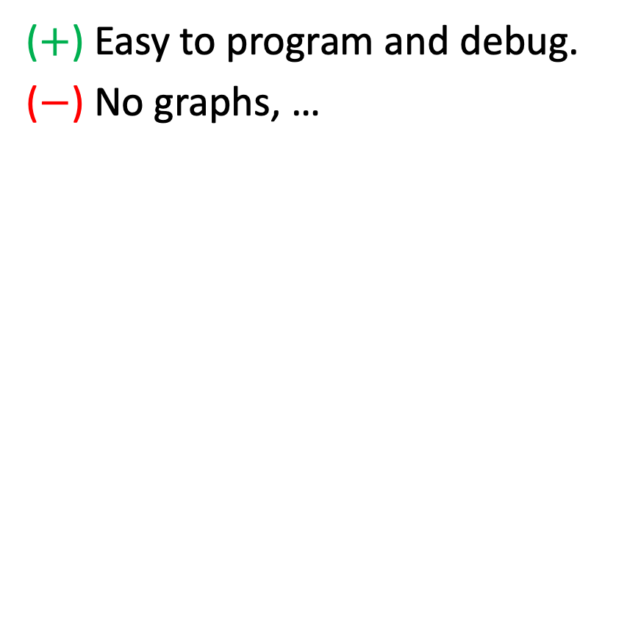
PyTorch
One of the prevalent machine learning frameworks that adopts imperative programming.
($+$) Easy to program and debug.
($−$) No graphs, …
Compiler Engineers
Optimizations
https://chips-compilers-mlsys-22.github.io/assets/slides/PyTorch%20Compilers%20(Compiler%20&%20Chips%20Symposium%202022).pdf

Slide 26
PyTorch
One of the prevalent machine learning frameworks that adopts imperative programming.
($+$) Easy to program and debug.
($−$) No graphs, …
Production Engineers
Deployments
https://chips-compilers-mlsys-22.github.io/assets/slides/PyTorch%20Compilers%20(Compiler%20&%20Chips%20Symposium%202022).pdf

Slide 27
PyTorch
One of the prevalent machine learning frameworks that adopts imperative programming.
($+$) Easy to program and debug.
($−$) No graphs, …
Chip Engineers
Performance
https://chips-compilers-mlsys-22.github.io/assets/slides/PyTorch%20Compilers%20(Compiler%20&%20Chips%20Symposium%202022).pdf

Slide 28

TensorFlow & PyTorch
TensorFlow
PyTorch
TensorFlow.Eager switched to imperative execution in 2018.
Gen1: torch.jit.script/trace
Gen2: torch.fx
Gen3: torch.Dynamo

Slide 29
PyTorch Gen1 Compiler
torch.jit.script
torch.jit.trace
An embedded language that moves outside of Python.
A tracer that records all the evaluated operators.
import torch
from torch.nn import Module
class MyModel(Module):
...
model = MyModel()
scripted_model = \
torch.jit.script(model)
traced_model = torch.jit.trace(
model, (sample_input,)
)

Slide 30
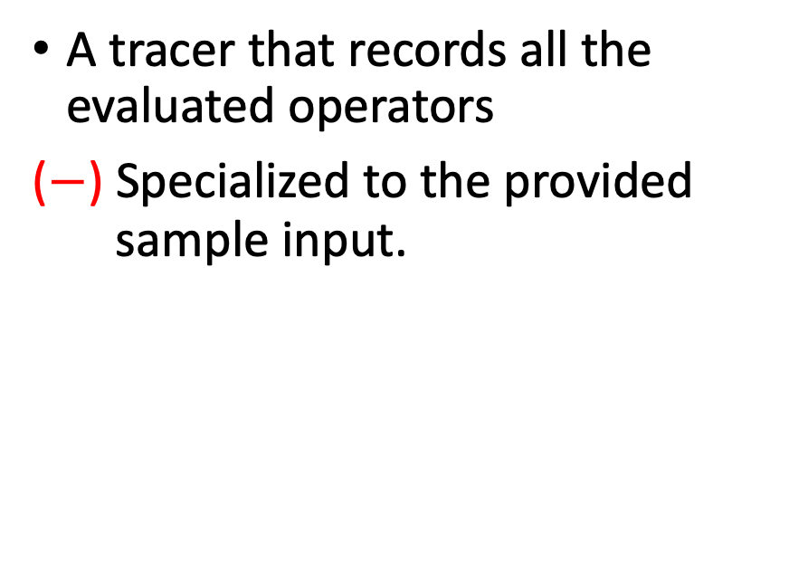
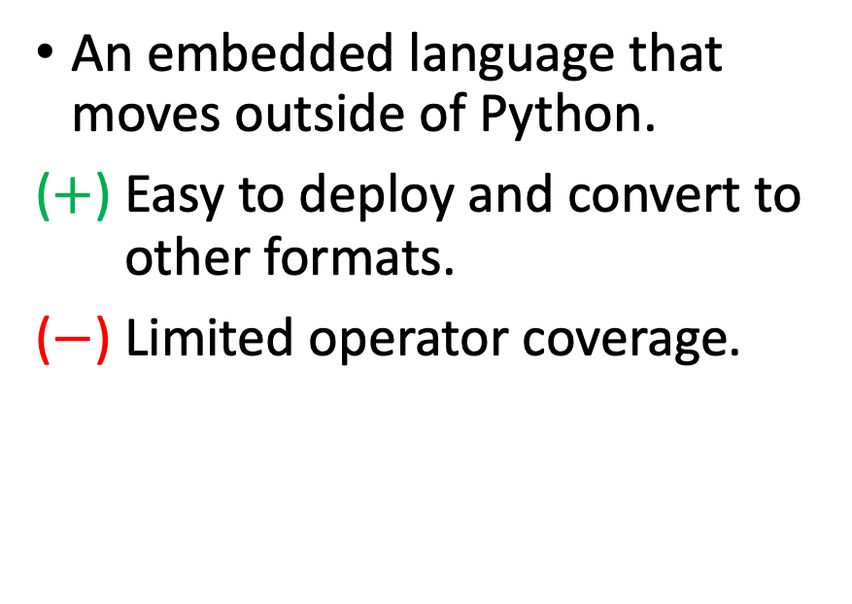
PyTorch Gen1 Compiler
torch.jit.script
torch.jit.trace
An embedded language that moves outside of Python.
($+$) Easy to deploy and convert to other formats.
($−$) Limited operator coverage.
A tracer that records all the evaluated operators
($−$) Specialized to the provided sample input.
scripted_model = \
torch.jit.script(model)
traced_model = torch.jit.trace(
model, (sample_input,)
)

Slide 31
PyTorch Gen2 Compiler torch.fx
Key Idea: Python-to-Python transformation.
3 main components:
Symbolic tracing
import torch
from torch.nn import Module
class MyModel(Module):
def forward(self, x, y):
return x + y
model = MyModel()
traced_model = \ torch.fx.symbolic_trace(module)
Feed in proxy inputs and record operations on them

Slide 32

PyTorch Gen2 Compiler torch.fx
Key Idea: Python-to-Python transformation.
3 main components:
Symbolic tracing
Duck 🦆-typed Python IR
import torch
from torch.nn import Module
class MyModel(Module):
def forward(self, x, y):
return x + y
model = MyModel()
fx_model = torch.fx.symbolic_trace(module)
print(fx_model.graph)
"""
graph():
%x : = placeholder[target=x]
%y : = placeholder[target=y]
%ret : = call_function[target=op.add](
args=(%x, %y), kwargs={}
)
"""
Operate on this representation

Slide 33
PyTorch Gen2 Compiler torch.fx
Key Idea: Python-to-Python transformation.
3 main components:
Symbolic tracing
Duck 🦆-typed Python IR
Python code generation
import torch
from torch.nn import Module
class MyModel(Module):
def forward(self, x, y):
return x + y
model = MyModel()
fx_model = torch.fx.symbolic_trace(module)
print(fx_model.graph)
fx_model.recompile()
print(fx.code)
"""
def forward(self, x, y):
return x + y
"""

Slide 34
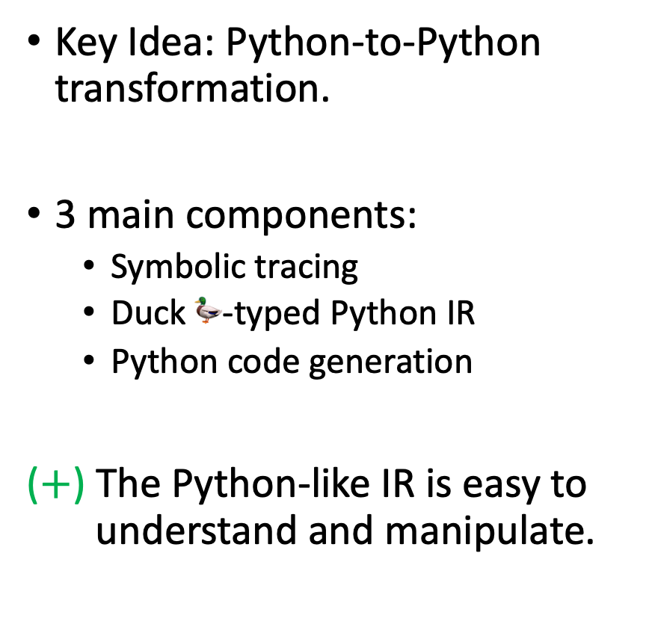
PyTorch Gen2 Compiler torch.fx
Key Idea: Python-to-Python transformation.
3 main components:
Symbolic tracing
Duck 🦆-typed Python IR
Python code generation
($+$) The Python-like IR is easy to understand and manipulate.
import torch
from torch.nn import Module
class MyModel(Module):
def forward(self, x, y):
return x + y
model = MyModel()
fx_model = torch.fx.symbolic_trace(module)
print(fx_model.graph)
fx_model.recompile()
print(fx.code)

Slide 35
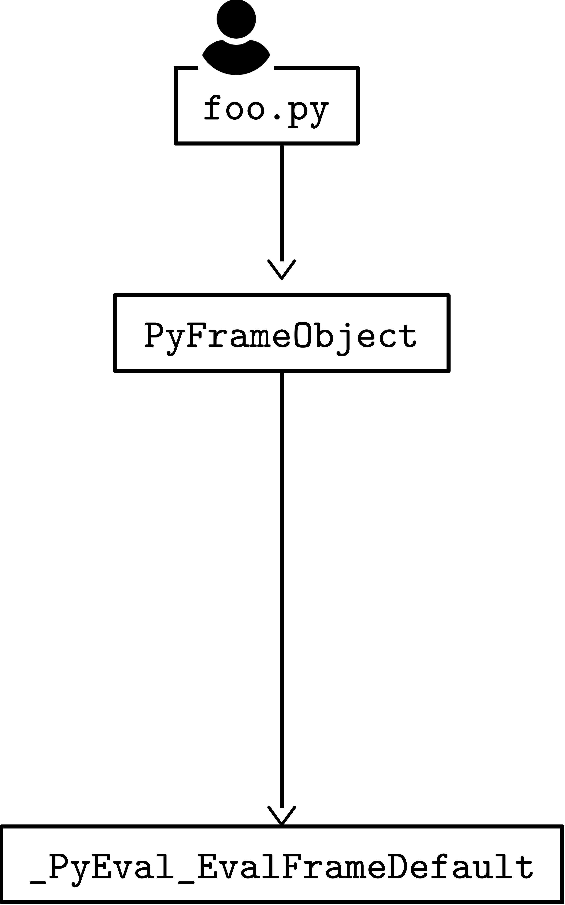
PyTorch Gen3 Compiler torch.Dynamo
Key Idea: torch.fx but supports partial capture.
https://chips-compilers-mlsys-22.github.io/assets/slides/PyTorch%20Compilers%20(Compiler%20&%20Chips%20Symposium%202022).pdf

Slide 36
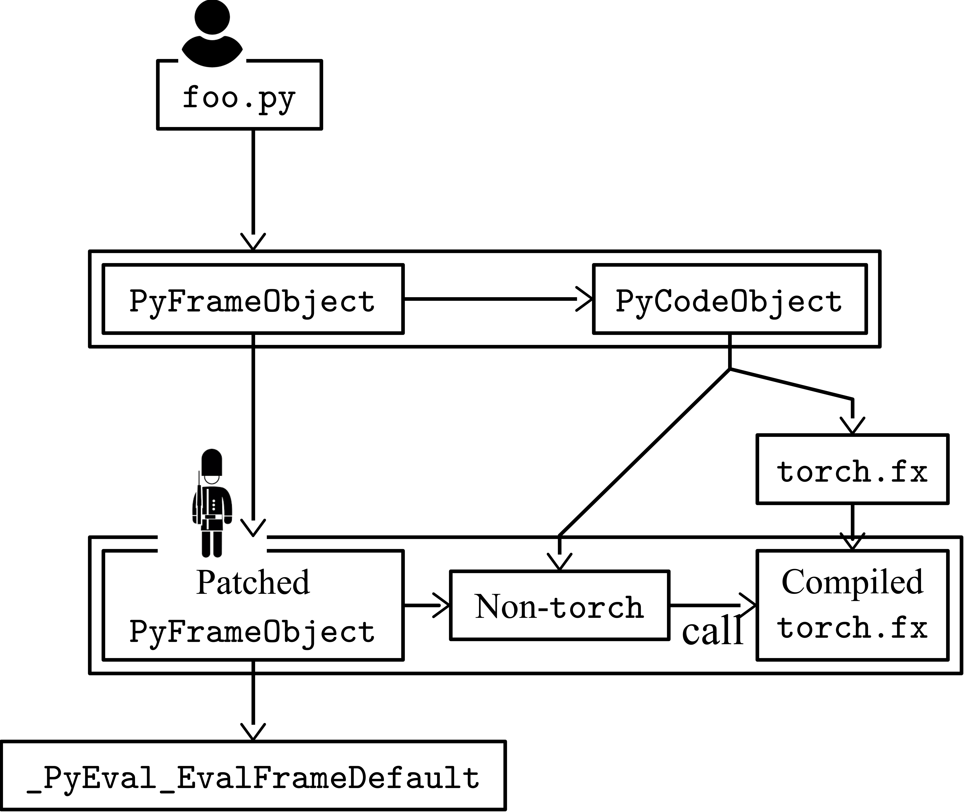
PyTorch Gen3 Compiler torch.Dynamo
Key Idea: torch.fx but supports partial capture.
import torch
def toy_example(a, b):
x = a / (torch.abs(a) + 1)
if b.sum() > 0:
b = b * -1
return x * b
def my_pass(fx_module, sample_inputs):
pass
with torch.dynamo.optimize(my_pass):
toy_example(
torch.randn(10), torch.randn(10)
)

Slide 37
PyTorch Gen3 Compiler torch.Dynamo
Key Idea: torch.fx but supports partial capture.
import torch
def toy_example(a, b):
x = a / (torch.abs(a) + 1)
if b.sum() > 0:
b = b * -1
return x * b
def my_pass(fx_module, sample_inputs):
pass
with torch.dynamo.optimize(my_pass):
toy_example(
torch.randn(10), torch.randn(10)
)

Slide 38
PyTorch Gen3 Compiler torch.Dynamo
Key Idea: torch.fx but supports partial capture.
import torch
def toy_example(a, b):
x = a / (torch.abs(a) + 1)
if b.sum() > 0:
b = b * -1
return x * b
def my_pass(fx_module, sample_inputs):
pass
with torch.dynamo.optimize(my_pass):
toy_example(
torch.randn(10), torch.randn(10)
)

Slide 39
PyTorch Gen3 Compiler torch.Dynamo
Key Idea: torch.fx but supports partial capture.
import torch
def toy_example(a, b):
x = a / (torch.abs(a) + 1)
if b.sum() > 0:
b = b * -1
return x * b
def my_pass(fx_module, sample_inputs):
pass
with torch.dynamo.optimize(my_pass):
toy_example(
torch.randn(10), torch.randn(10)
)

Slide 40
Section Summary
MLSys Overview
TensorFlow and PyTorch
Declarative vs. Imperative
Evolution of PyTorch Compilers
Gen1: Scripting and tracing
Gen2: Ducked-type Python IR
Gen3: Partial capture
Can jump out of those existing systems and create much more powerful wheels!
Please support the research work Hidet from my colleague Yaoyao: www.github.com/hidet-org/hidet by staring the repository.

Slide 41
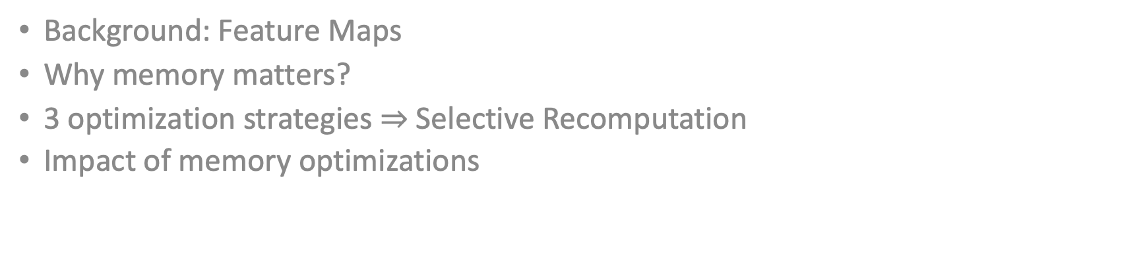
Memory Optimizations
Background: Feature Maps
Why memory matters?
3 optimization strategies $⇒$ Selective Recomputation
Impact of memory optimizations

Slide 42
Deep Neural Networks
3 phases:
❶ Forward Pass
Deep Neural Network
Model parameters W

Slide 43
Deep Neural Networks
3 phases:
❶ Forward Pass, ❷ Backward Pass
Deep Neural Network
Training loss
Model parameters W

Slide 44
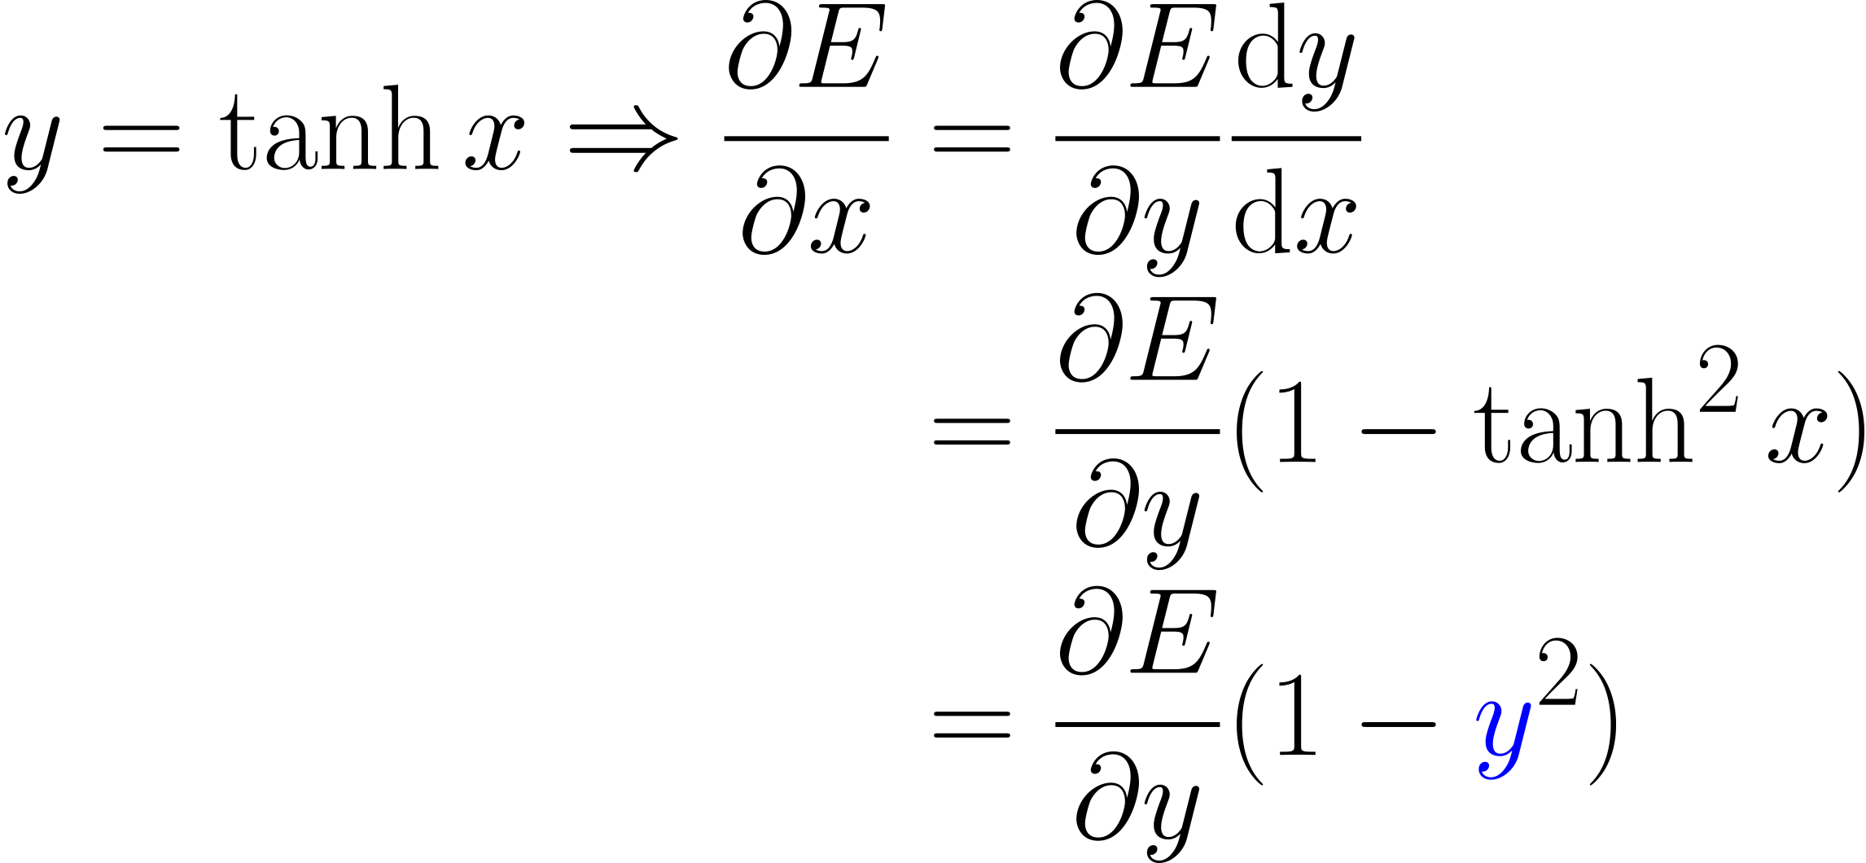
Feature Maps
Data entries that are stashed by the forward pass to compute the backward gradients.

Slide 45

Feature Maps
Data entries that are stashed by the forward pass to compute the backward gradients.
Feature Maps
Storage In-Use
1
2
3
4
Large temporal gap between usage
Total Memory Consumption

Slide 46

GPU Memory Consumption Profile of A Machine Translation Workload
$$87\%$$
Feature maps dominate the GPU memory consumption

Slide 47
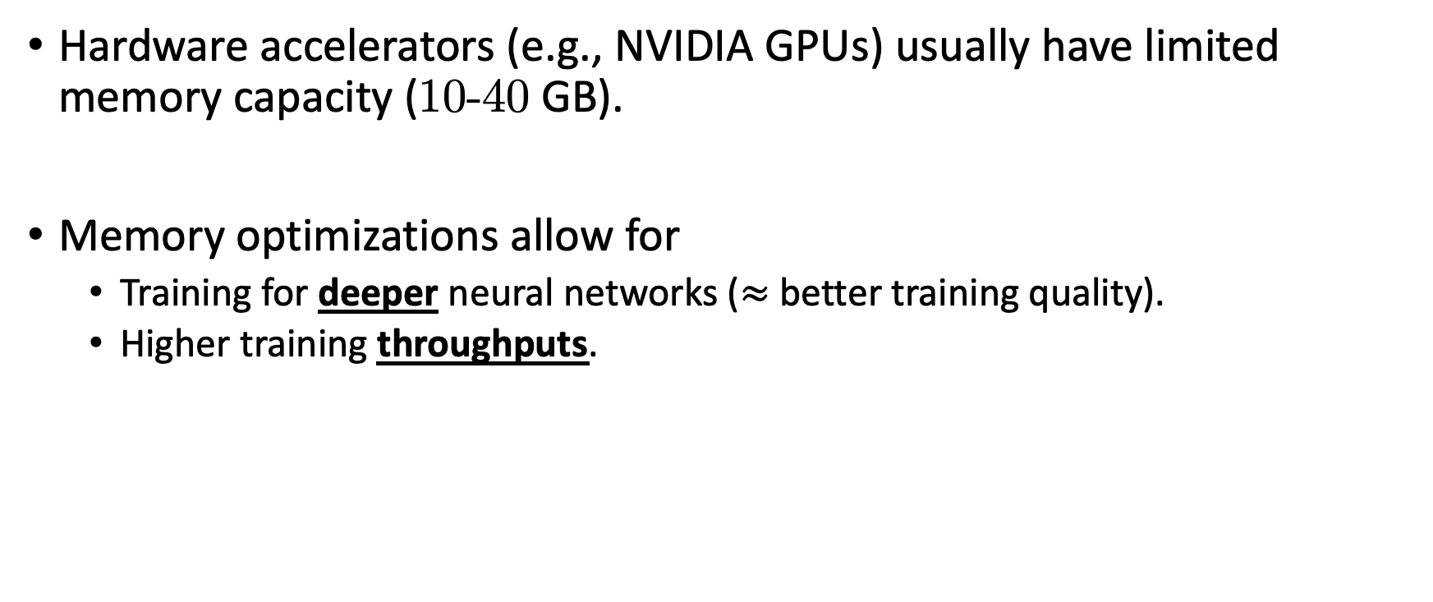
Why memory matters?
Hardware accelerators (e.g., NVIDIA GPUs) usually have limited memory capacity (10-40 GB).
Memory optimizations allow for
Training for deeper neural networks ($≈$ better training quality).
Higher training throughputs.

Slide 48

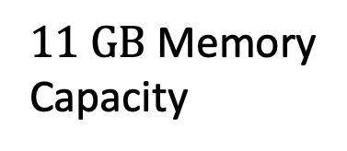
Memory $→$ Training Throughputs
When training, data is usually batched for higher throughput and faster convergence.
Throughput and memory consumption of English-Vietnamese translation on a NVIDIA 2080 Ti GPU
$11 GB$ Memory Capacity

Slide 49
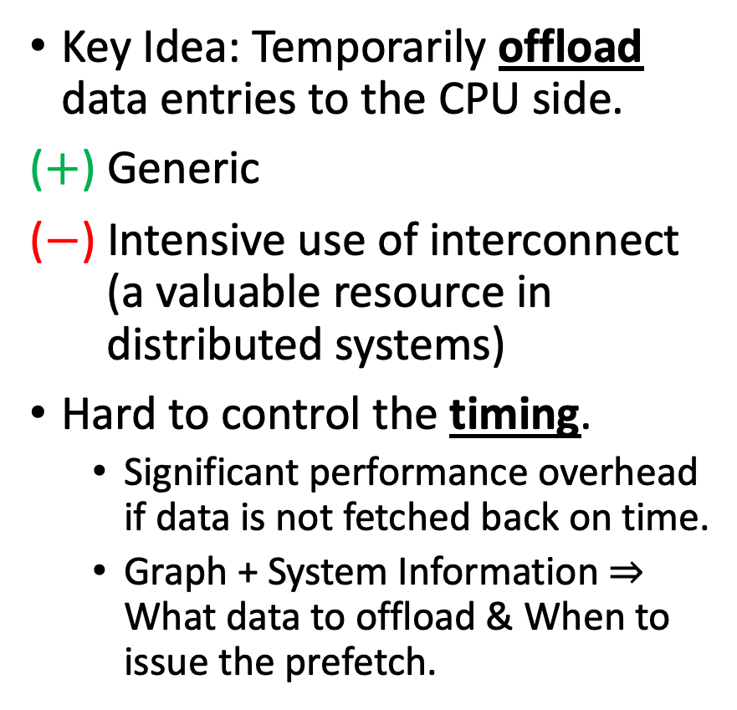
Strategy #1. Virtualization
Key Idea: Temporarily offload data entries to the CPU side.
($+$) Generic
($−$) Intensive use of interconnect (a valuable resource in distributed systems)
Hard to control the timing.
Significant performance overhead if data is not fetched back on time.
Graph + System Information $⇒$ What data to offload & When to issue the prefetch.
PCIe

Slide 50

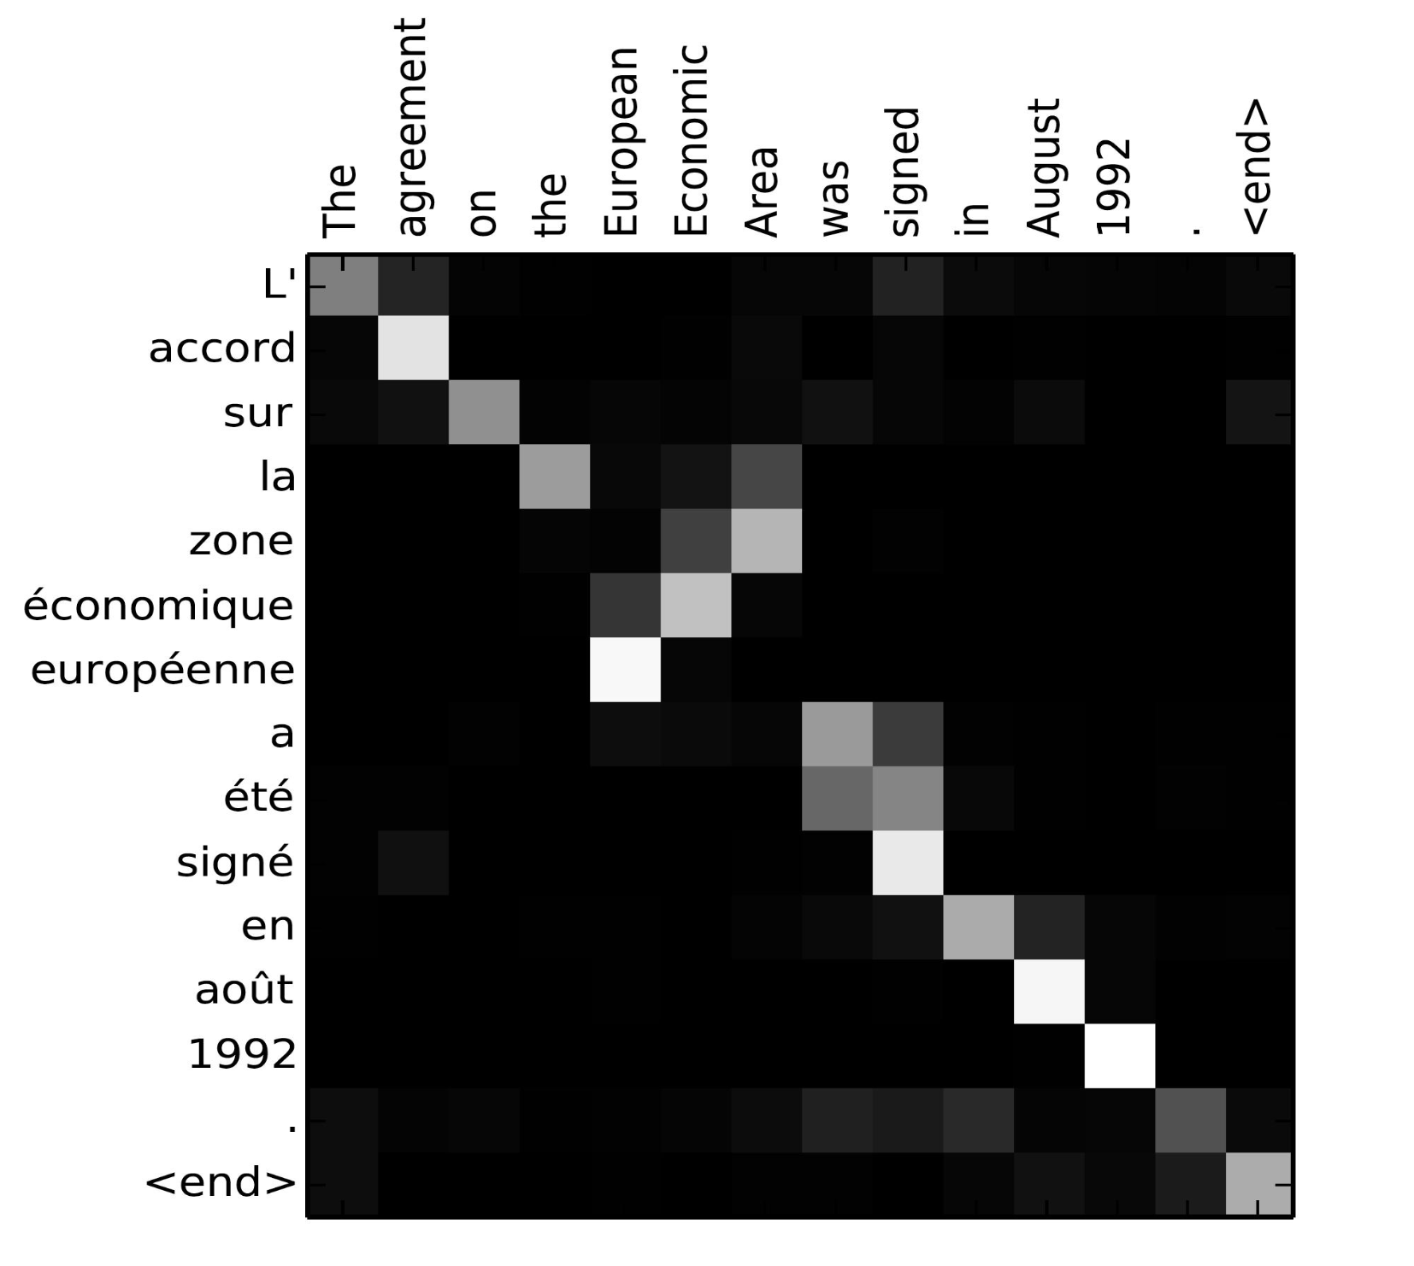
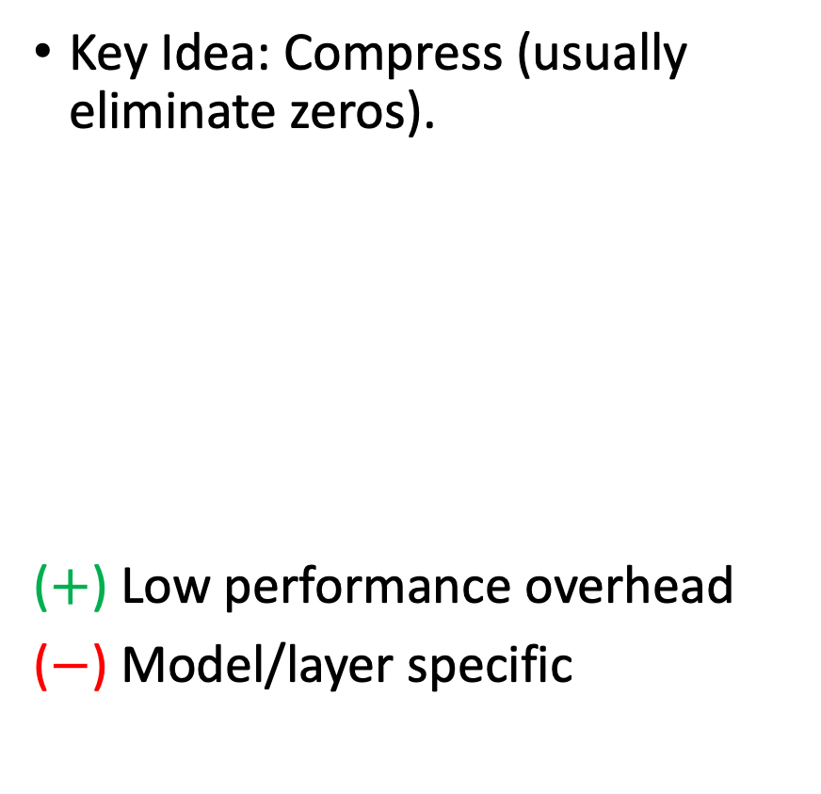
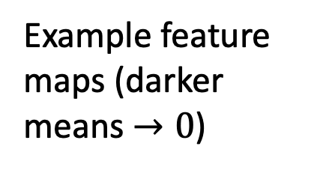
Strategy #2. Data Encoding
Key Idea: Compress (usually eliminate zeros).
($+$) Low performance overhead
($−$) Model/layer specific
Example feature maps (darker means $→0$)

Slide 51

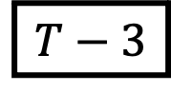
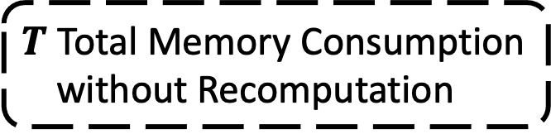
Strategy #3. Selective Recomputation
Key Idea: Trade runtime with memory capacity.
The recomputation path should only involve lightweight operators.
$T$ Total Memory Consumption without Recomputation
Feature Maps
Storage In-Use
1
2
3
$$T−3$$
4
Recomputation
Recomputation Path

Slide 52

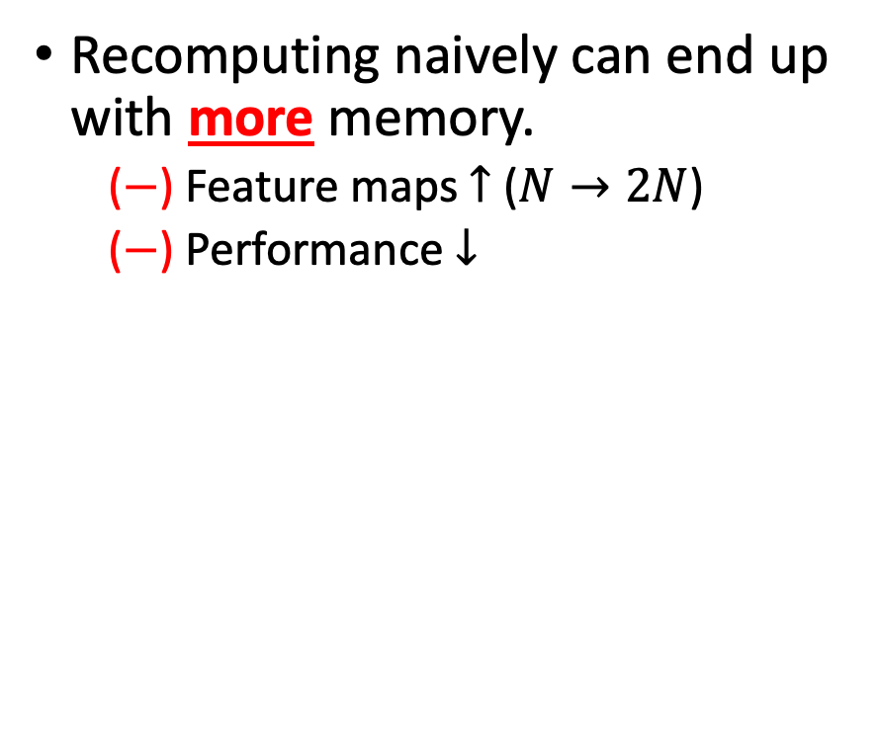
Strategy #3. Selective Recomputation
Recomputing naively can end up with more memory.
($−$) Feature maps $↑$ ($N→2N$)
($−$) Performance $↓$
LOSE

Slide 53
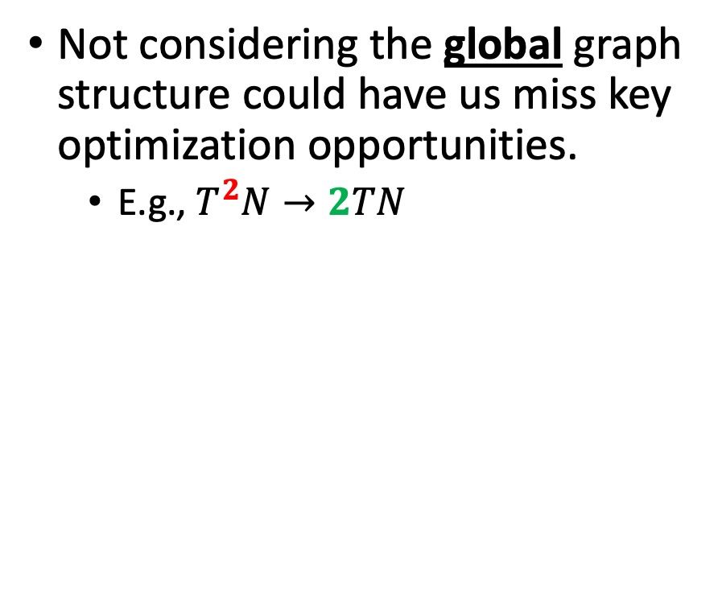
Strategy #3. Selective Recomputation
Not considering the global graph structure could have us miss key optimization opportunities.
E.g., $T^{2}N→2TN$
Want to know the sweet spot where doing recomputation is optimal
Our approach: Bidirectional Analysis

Slide 54
Bidirectional Analysis
▼Backward Pass
Breaks at compute-heavy layers to partition the graph
Constructs a recomputation path that consists of nodes visited
Compute-Heavy Layers

Slide 55
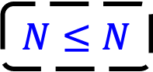
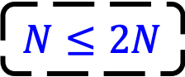
Bidirectional Analysis
▼Backward Pass
Breaks at compute-heavy layers to partition the graph.
Constructs a recomputation path that consists of nodes visited.
▲Forward Pass
Remove operator nodes from the recomputation path if
$$N≤2N$$
$$N≤N$$

Slide 56
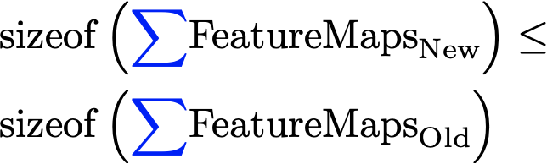
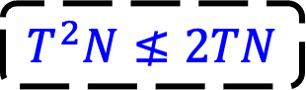
Bidirectional Analysis
Tensor sharing causes all the correlated operators to forward propagate simultaneously:
$$T^{2}N≰2TN$$

Slide 57
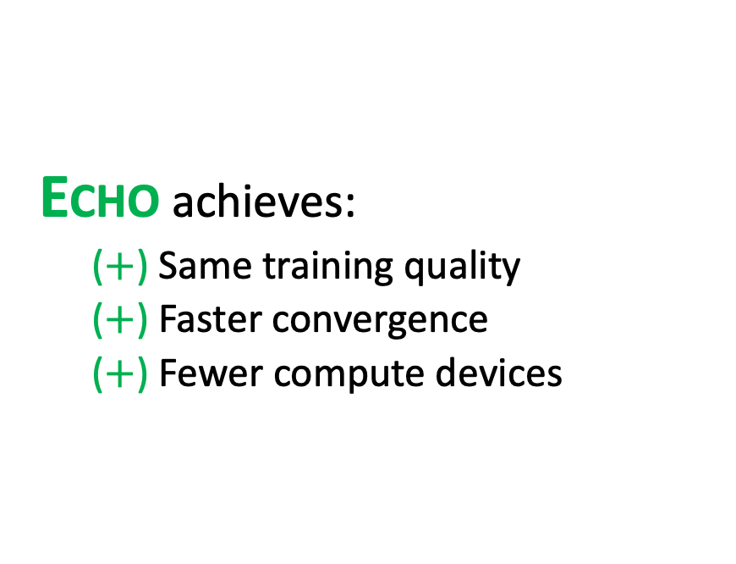
Evaluation
English-German translation with the same number of training steps
ECHO achieves:
($+$) Same training quality
($+$) Faster convergence
($+$) Fewer compute devices
Better

Slide 58
Section Summary
Why memory matters?
Deeper neural networks
Higher training throughputs
3 Optimization Strategies:
Virtualization
Data Encoding
Selective Recomputation (formulated as a bidirectional analysis)
Impact of memory optimizations
Same training quality
Faster convergence
Fewer compute devices

Slide 59
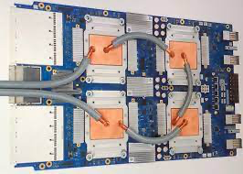
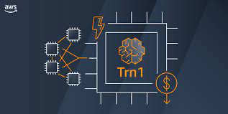

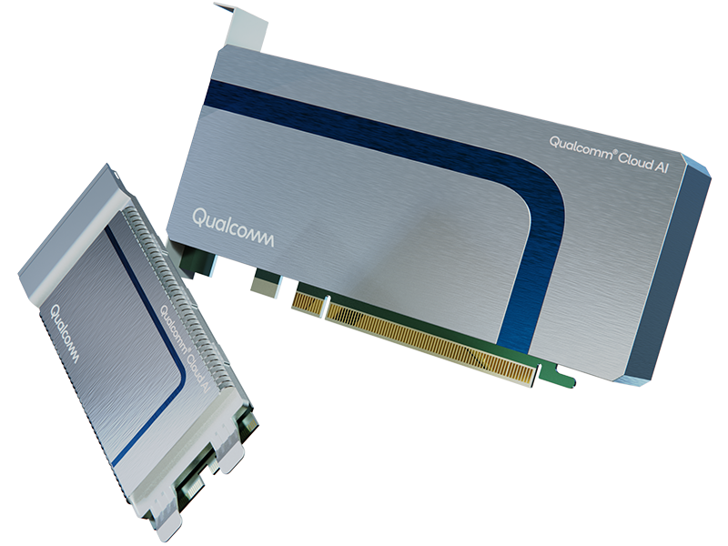
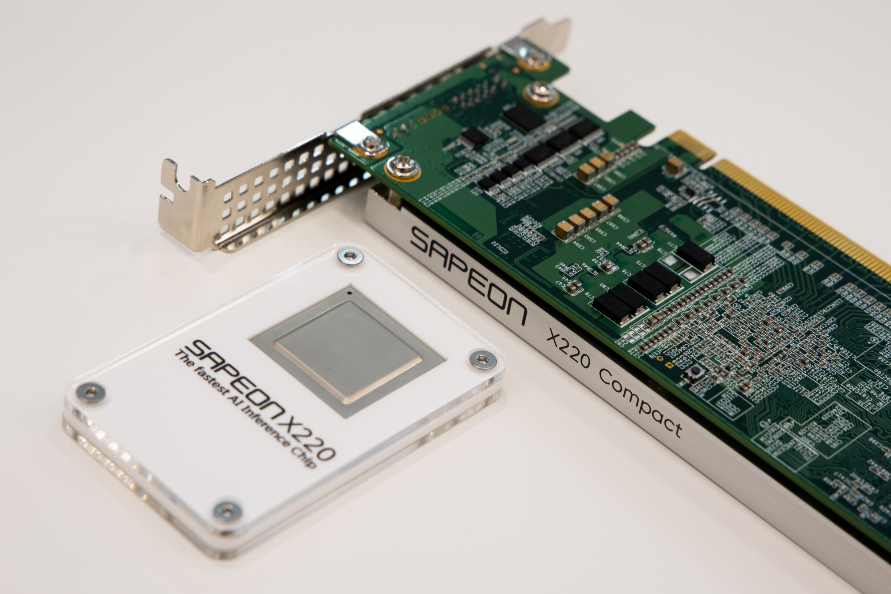
Future Vision
Google TPU
AWS Trainium
Qualcomm Cloud AI 100
SAPEON X220
Compute power cannot be exploited without a mighty compiler stack.

Slide 60
Compiler Optimizations for Machine Learning Workloads
Bojian Zheng
CSCD70 Compiler Optimization
2023/3/20

